Slide 1




Identifying Suicidal Tendency among Young Students of Bangladesh Using Machine Learning

Slide 2




Presented By
Group-23
Nahidul Islam
Md. Shakil Hossain
Mahbubur Rahman
Roll-2028
Roll-2023
Roll-2024

Slide 3


Contents
01
02
03
Introduction
Objective
Suicide Rate
04
05
06
Research Question
Literature review
Data Description
07
08
09
Proposed Model
Project Plan
Conclusion

Slide 4


Introduction
The thesis proposes a machine learning approach for Identifying Suicidal Tendencies among Young Students in Bangladesh Using Machine Learning. The approach involves collecting data on student characteristics and behaviours, preprocessing and engineering the data to create features suitable for machine learning, evaluating various machine learning models, and deploying the best-performing model to a production environment.
The thesis concludes that the proposed machine learning approach has the potential to significantly improve the ability to predict suicide risk among students in Bangladesh. This could lead to earlier intervention and prevention of suicide, which would save lives.

Slide 5


Objectives
Develop a machine learning model that can analyze patterns and identify potential signs of suicidal tendencies in young students based on their online activities, such as social media posts, search history, and online interactions.
01
Collect and analyze a comprehensive dataset consisting of various factors related to mental health, such as depression symptoms, anxiety levels, stressors, and previous history of self-harm or suicidal ideation among young students in Bangladesh.
02
Explore different machine learning algorithms, such as decision trees, logistic regression, or support vector machines, to build a predictive model that can accurately detect and classify young students at risk of suicidal tendencies.
03

Slide 6
Continue...
Collaborate with mental health professionals, educators, and counsellors to incorporate their expertise and domain knowledge into the model development process, ensuring the inclusion of relevant features and validation of the results.
04
Evaluate the machine learning model’s performance using appropriate metrics, such as accuracy, precision, recall, and F1 score, to measure its effectiveness in identifying and predicting suicidal tendencies among young students.
05

Slide 7

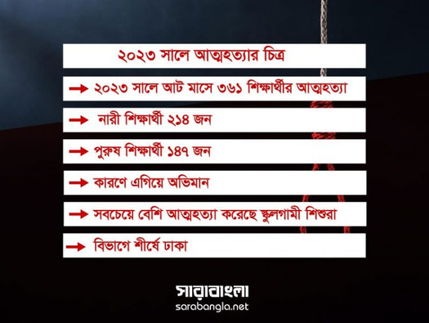
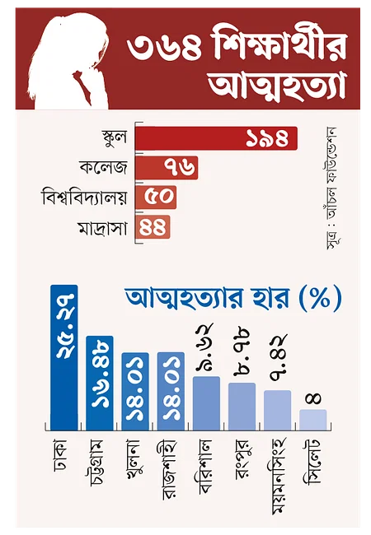
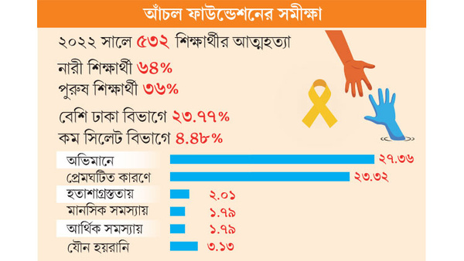
Suicide Rate

Slide 8
Research Question
Can a machine learning approach be used to predict suicide risk among Young Students in Bangladesh accurately?

Slide 9
Literature Review
Authors/Title | Findings
Ryan M. Hill, Benjamin Ooster- hoff and Calvin Do
“Using Machine Learning to Identify Suicide Risk: A Classification Tree Ap- proach to Prospectively Identify Adolescent Suicide Attempters”
The findings showed that two classification tree solutions, with corresponding sensitivity/specificity ratios of 90.6%/70.9% and 69.8%/85.7%, maximized risk prediction.
Melissa Macalli1,7, Marie Navarro1,7, Massimiliano Orri1,2, Marie Tournier1,3, Rodolphe Thi´ebaut1,4,5, Sylvana M. Cˆot´e1,6 and Christophe
“A Tzourio1 approach for predicting suicidal thoughts and behaviours among col- lege students”
With an AUC of 0.8, sensitivity of 79% for girls and 81% for boys, and positive predictive value of 40% for females and 36% for boys, the models demonstrated strong predictive performance.

Slide 10






We used a survey form to collect data by asking different questions. We divide our form into 2 sections. In the first section, we ask about their age, education level, division and so on.
In the second section, we ask them different types of questions that are related to suicide. For example, Is there a history of suicide in your family? Have you ever expressed your feelings of depression to someone?
Data Description
Form Link
https://forms.gle/kWd2LFtGwnUfyGRSA

Slide 11

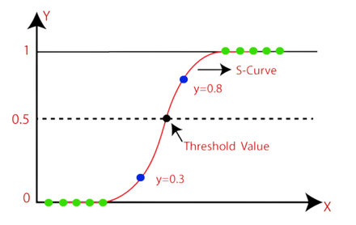
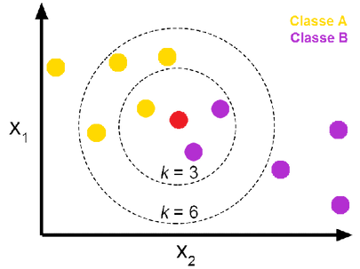
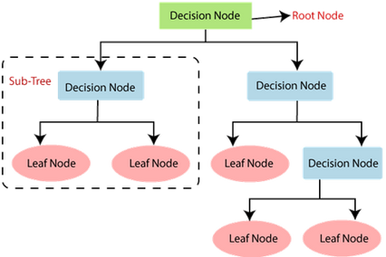
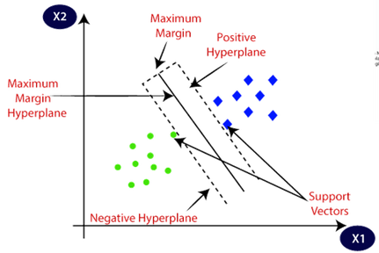
Proposed Model
Logistic Regression
K-Nearest Neighbor (KNN)
Support Vector Machine
Discission Tree
Logistic regression models the probability of a discrete outcome given an input variable. The most common logistic regression model is a binary outcome, which can take two values: true/false, yes/no, and so on.
The k-nearest neighbors algorithm, also known as KNN or k-NN, is a non-parametric, supervised learning classifier, which uses proximity to make classifications or predictions about the grouping of an individual data point.
Support Vector Machine is a supervised machine learning algorithm that can be used for classification or regression tasks. The basic idea behind SVM is to find a hyperplane in an N-dimensional space that distinctly classifies the data points.
A decision tree is a non-parametric supervised learning algorithm for classification and regression tasks. It has a hierarchical tree structure consisting of a root node, branches, internal nodes and leaf nodes.

Slide 12
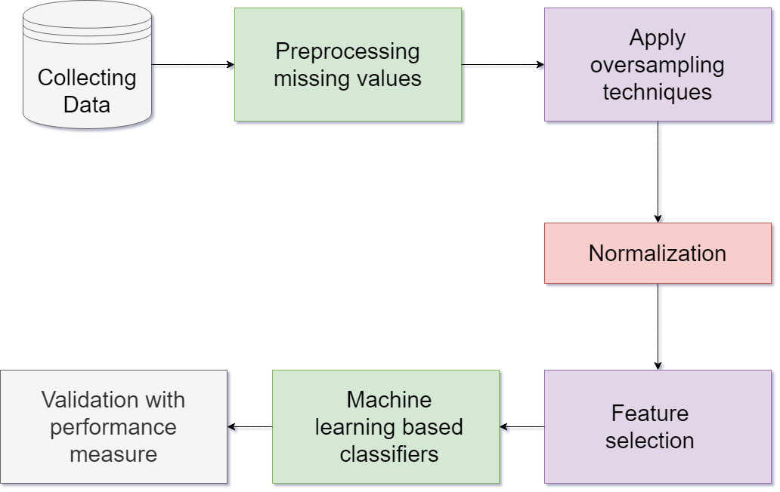
Methodology

Slide 13
Conclusion
Suicide is a major public health problem in Bangladesh, and young students are particularly at risk. Early identification and intervention are essential for preventing suicide among young people. Machine learning has the potential to play a significant role in improving the early identification and prevention of suicide among young students. This study has demonstrated the feasibility of using machine learning to identify young students at risk of suicide in Bangladesh.

Slide 14

THANK YOU!

